Slide 1
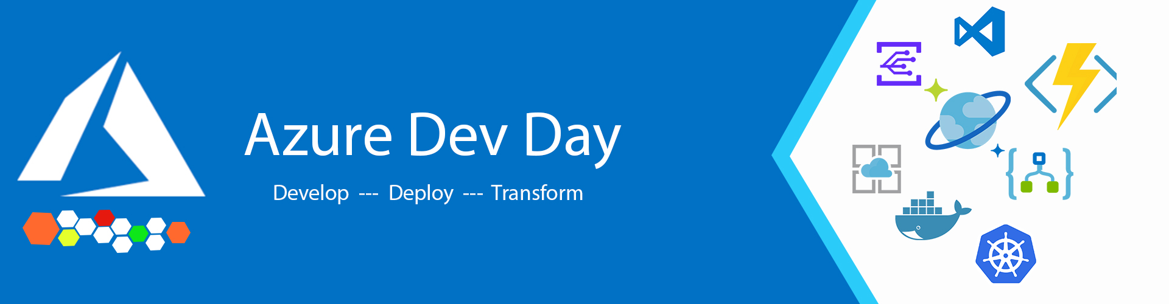

Microservices and Containers
Presenter : Ralph Wheaton
Architect - Daugherty Business Systems

Slide 2
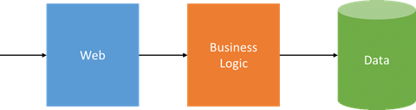
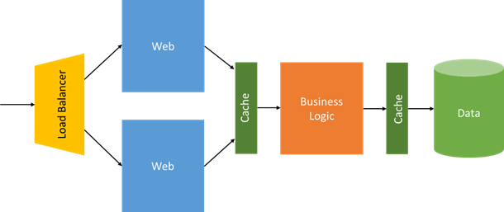
Monolithic Application Models

Slide 3
What are Microservices?
Microservices is a software development technique—a variant of the service-oriented architecture (SOA) architectural style that structures an application as a collection of loosely coupled services. In a microservices architecture, services are fine-grained and the protocols are lightweight.
The benefit of decomposing an application into different smaller services is that it improves modularity and makes the application easier to understand, develop and test. It also parallelizes development by enabling small autonomous teams to develop, deploy and scale their respective services independently. It also allows the architecture of an individual service to emerge through continuous refactoring. Microservices-based architectures enable continuous delivery and deployment.

Slide 4
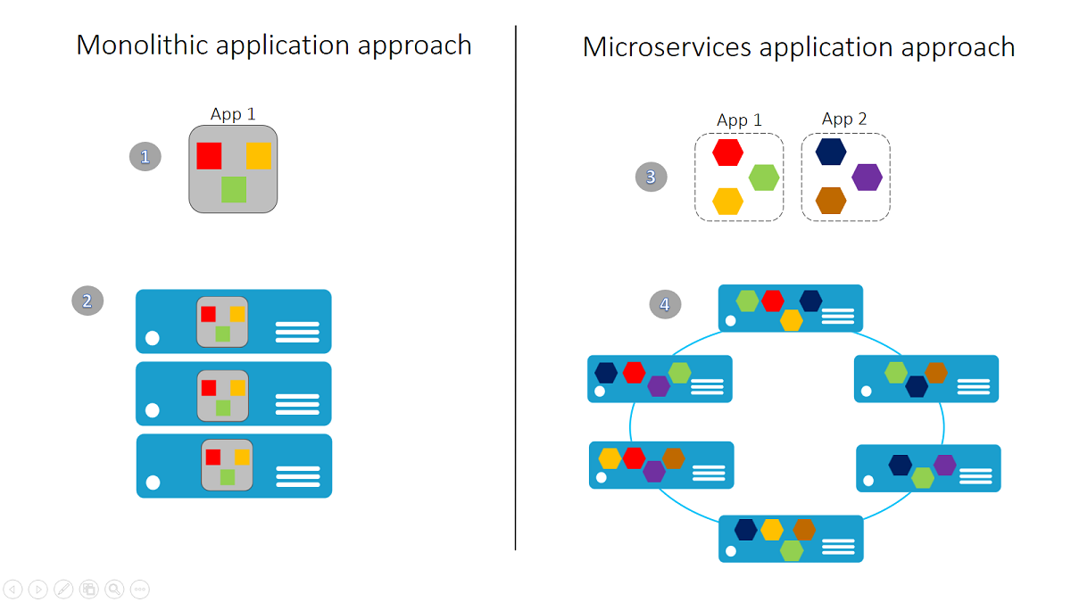
Monolithic vs. Microservice Application Approach

Slide 5
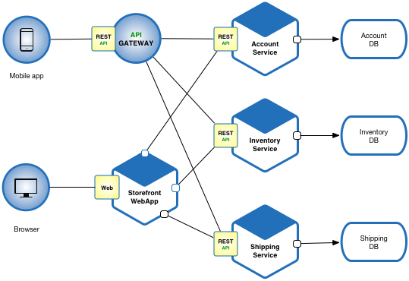
Microservice Architecture

Slide 6
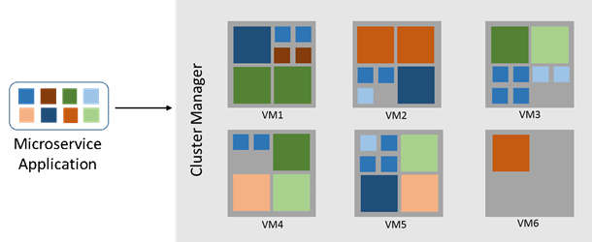
Microservice Deployment

Slide 7
Benefits of Microservices
Smaller Functional Pieces
Less code
Maintainability
Manageable team sizes
Greater Agility
Quicker turnaround
Less intensive regression tests
Less complex deployments
Decouple
Reuse
Agnostic Technology
Best tool, best place
Scalability
Scale out based upon component utilization
Resiliency
Data isolation
Versioning

Slide 8
Challenges of Microservices
Service Boundaries
Communication between the application and services
Communication between services
Security
Multiple endpoints
Multiple technologies
Network
Congestion
Latency
Complexity
Functional boundaries
Multiple endpoints
Cross functional services
Versioning
Monitoring
Troubleshooting

Slide 9
Hosting Microservices
Azure Web App
Azure Functions
Service Fabric
Azure
On Premises
Azure Container Service (AKS)

Slide 10
Service Fabric

Slide 11

Service Fabric
Microsoft’s Container Orchestrator
Azure or On Premises (Windows, Linux)
Stateless and Stateful Microservices
Use Service Fabric Programming Model, ASP.NET Core, Node.js, Java, …
Supports Windows and Linux Containers

Slide 12
Service Fabric
Build, deploy, and operate applications, using any OS, at any scale, on any cloud
Build
Deploy
Operate
Build new or transform existing applications
Deploy any code at any scale using tools you know
Run and secure services reliably at any scale

Slide 13

Proven Platform Powering Core Azure and Microsoft Services
SQL Database
Microsoft has deep expertise in running global services such as Cortana, Skype & Cosmos DB
Service Fabric is the foundational technology powering these services & core Azure infrastructure
Sample scale of one of these services: 60 billion events per day with millions of databases
About 30% of Azure’s cores run Service Fabric directly.
Service Fabric Manages Millions of Service upgrades weekly within Microsoft alone
SQL
Power BI
{ }
Cosmos DB
Dynamics
IoT Hub
Intune
Event Hub
Cortana
Skype

Slide 14
Containers

Slide 15


What is a container?
Containers
= Operating system virtualization
OS
Any OS
Container
Container
Container
Applications
Linux
Windows
Kernel
Anywhere
Hardware
On-premises
Cloud
Traditional VMs = hardware virtualization
Any app
Monolith
Microservice
Application
VM
VM
VM
Any language
OS
Java
.Net
Hardware

Slide 16
Containers Deliver Speed, Flexibility and Savings
Agility
Portability
Rapid Scale
Ship apps faster
Easily move workloads
Scale application to meet demand

Slide 17
Containers as a Common Deployment Currency
Azure Container Instance
App Service
Service
Fabric
Open Source
Docker, Kubernetes, Mesosphere, OpenShift
Azure Container Registry
Azure Container Service (AKS)
Azure Container Registry
Choice of developer tools & clients

Slide 18
Container Orchestrator Features
Automatic binpacking
Horizontal scaling
Self-healing
Service discovery and load balancing
Automated rollouts and rollbacks
Secret and configuration management
Storage orchestration
Batch execution
Notes:
Binpacking – places containers based upon their resource requirements and other constraints, while not sacrificing availability. Mix critical and best-effort workloads in order to drive up utilization and save even more resources.

Slide 19
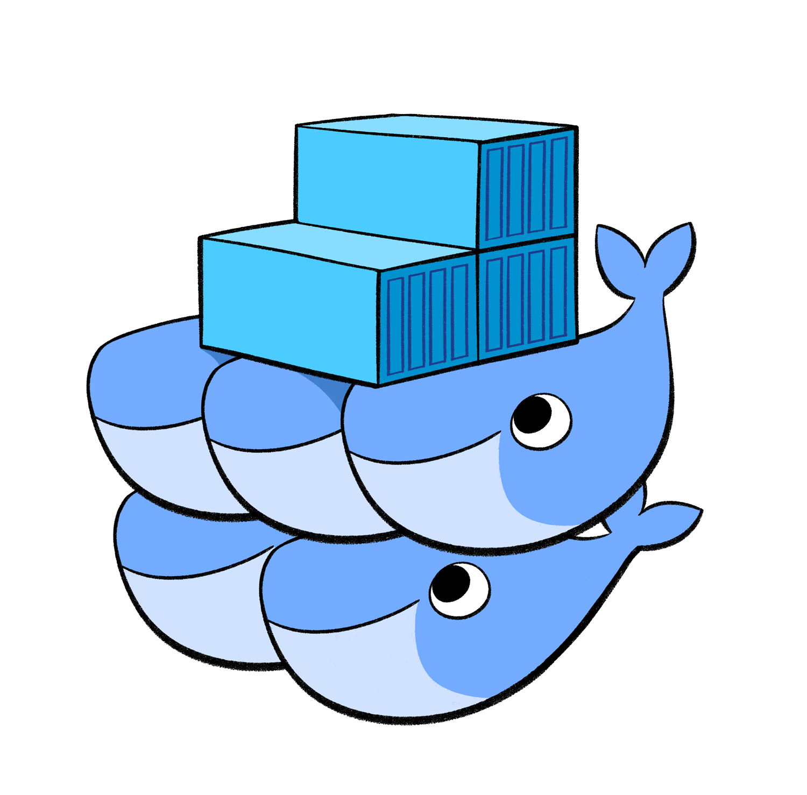

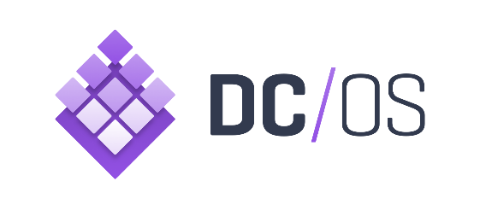
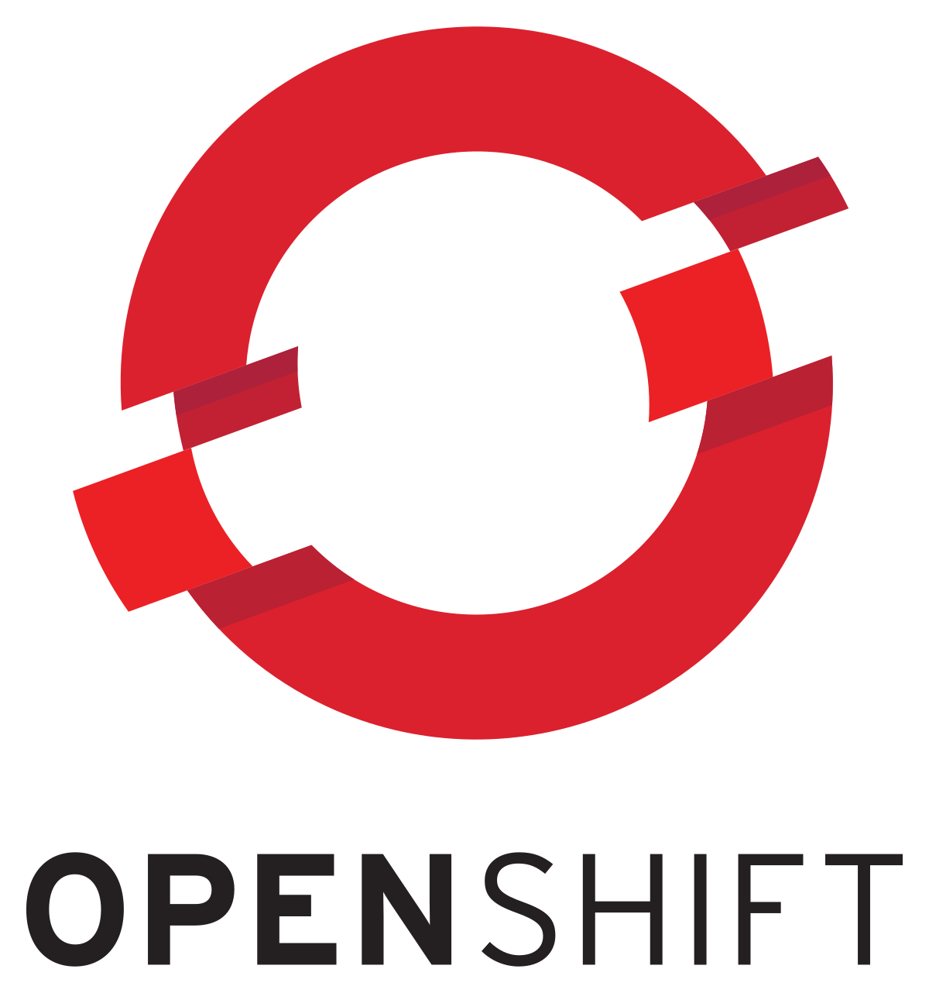
Container Orchestrators
Notes:
Kubernetes
Docker
dc/os - combining the power of Apache Mesos with Mesosphere’s Marathon and many other important container management technologies
Openshift – Red Hat – not supported by AKS, must be deployed to Azure
Service Fabric

Slide 20
Azure Container Service (AKS)
Automated Kubernetes version upgrades and patching
1
Easy cluster scaling
2
Self-healing hosted control plane (masters)
3
Cost savings - pay only for running agent pool nodes
4

Slide 21

Azure Container Instance
Fast Startup times
Hypervisor-level security
Custom size
Public IP connectivity
Persistent storage
Linux and Windows containers
Co-scheduled groups

Slide 22
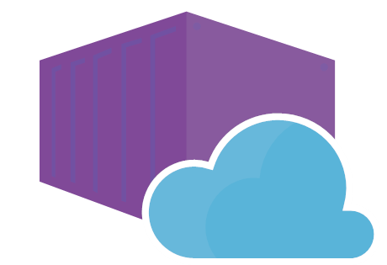
Azure App Service-Web App for Container
Easily deploy and run containerized applications
Use a fully-managed platform
Built-in auto scaling and load balancing
Streamline CI/CD

Slide 23
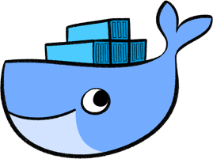





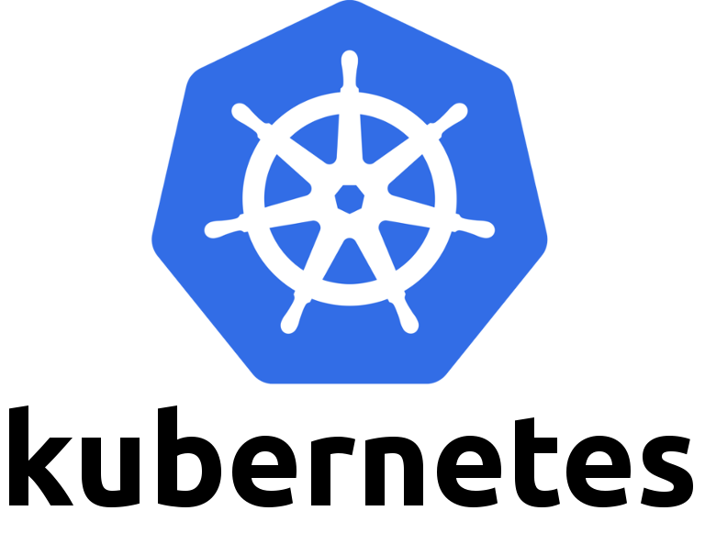
Container CI/CD
Build
Release
VSTS
ACR
Azure Web App
VS Code
github
Code
Dockerfile
Hub

Slide 24
Resources
Microservices
Azure Managed Kubernetes(AKS)
kubernetes.io
Azure Service Fabric

Slide 25


Thank You
@theunstablemind
ralph.wheaton@daugherty.com

